Slide 1


AGE 219: Control Flow
and Program Logic
Decision Making in Agricultural Computing
Dr. Kadeghe Fue, PhD, P.Eng (T)
AI & Robotics | Office: EPAL | SoET SUA

Slide 2
Recap of Lecture 2
We mastered Variables, Data Types (Int, Float, String, Bool), and Arithmetic Operators for engineering calculations.

Slide 3


What is Control Flow?
Linear vs Conditional
Agricultural Use Case
By default, Python runs code line-by-line (Linear). Control flow allows us to skip or repeat lines based on conditions.
Problem: Should we irrigate?
Decision: If soil moisture is below 30%, then open the solenoid valve. Otherwise, keep it closed.
This is the "Brain" of the program, allowing the computer to make autonomous decisions.

Slide 4
Comparison Operators
Operators used to compare two values, resulting in a Boolean (True/False).
Operator | Meaning | Example | Result
== | Equal to | 5 == 5 | True
!= | Not equal to | 5 != 3 | True
> | Greater than | 10 > 20 | False
< | Less than | moisture < 30 | Variable
>= | Greater or equal | temp >= 35.0 | Variable

Slide 5

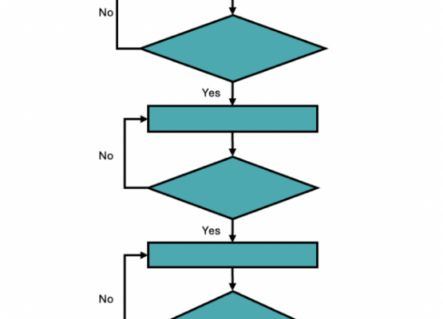

The "if" Statement
The if statement executes a block of code ONLY if the condition is True.
Note the colon (:) and the mandatory indentation.

Slide 6






Selection Structures
if-else
if-elif-else
Nested Logic
The "Binary" choice. If condition is true, do A. Otherwise, do B.
Multiple conditions. Used for grading or multi-state systems.
An "if" statement inside another "if". For complex dependencies.

Slide 7
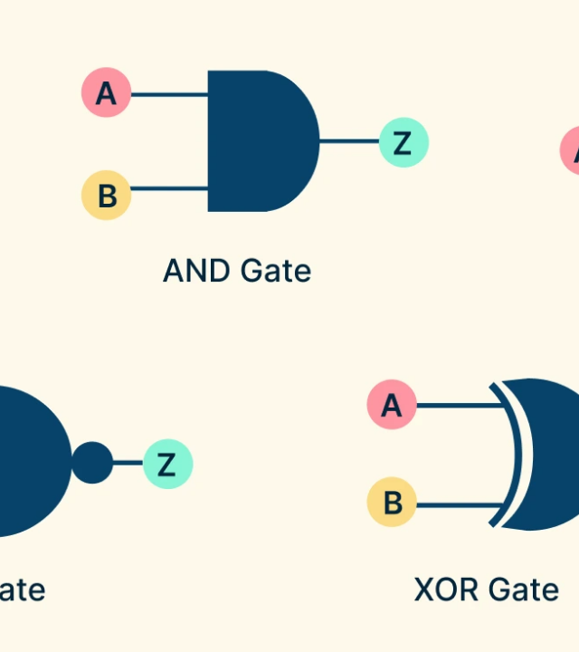
Logical Operators
Combine multiple conditions into one expression.
and: True if BOTH are true.
or: True if AT LEAST one is true.
not: Inverts the Boolean value.

Slide 8
The Truth Table (AND/OR)
Essential for validating complex engineering logic.
A | B | A and B | A or B
True | True | True | True
True | False | False | True
False | True | False | True
False | False | False | False

Slide 9


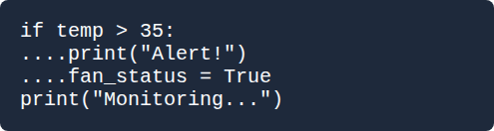
The Indentation Rule
Scope and Whitespace
Visual Structure
Unlike other languages that use curly braces {}, Python uses Indentation (4 spaces) to define code blocks.
Improper indentation causes an IndentationError.
The last line runs regardless of temperature.

Slide 10
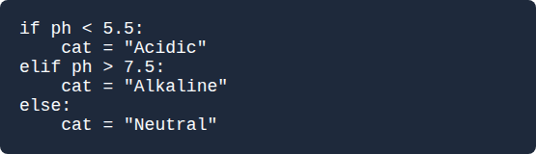
The "elif" Chain
Handling multiple categories (e.g., Soil pH Levels):
Checks from top to bottom.
Stops at the FIRST True match.
else is the final catch-all.

Slide 11

Logic in Action
Engineering Case Studies at SoET

Slide 12
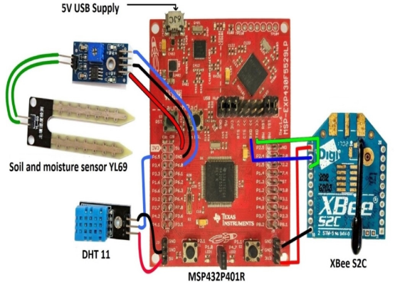
Case Study: Smart Controller
System Logic
Goal: Optimize energy and water.
Criteria:
1. Moisture < 25%
2. NOT currently raining
3. Time is after 6 PM
We use the and operator to combine these three sensors into one command.

Slide 13

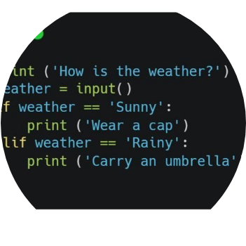
Nested Logic Safety
The Hierarchy of Checks
In autonomous tractors, we use nested logic for safety interlocks:
IF power is ON:
IF obstacle detected:
STOP tractor
ELSE:
CONTINUE path

Slide 14
Logic Density
80%
Why Logic Errors Matter
Statistical analysis shows that 80% of autonomous agricultural equipment failures stem from "Logical Edge Cases" — scenarios the programmer didn't predict.
AUTOMATION FAILURE
In this course, we learn to "Stress Test" our logic using Truth Tables before deployment.

Slide 15
Selection Structure Summary
Structure | When to use | Logic Diagram
if | Single task check | Diamond (One Exit)
if-else | Binary choice (A or B) | Diamond (Two Exits)
if-elif-else | Multiple Categories | Chain of Diamonds
Nested if | Sub-conditions | Diamond within Branch

Slide 16


Questions?
Thank you for your attention.
Next Lecture: Iteration — Automating Repetition with Loops
School of Engineering and Technology (SoET) | Office: EPAL

